Slide 1
Bridging News and Leaks
SMUBIA
Presented by: DataWizards

Slide 2
Today’s Challenges
Rise of misinformation & foreign influence
Difficulty detecting manipulated narratives
ISD’s Mission:
Safeguard national security by preventing terrorism, espionage, and internal threats, while monitoring emerging risks like foreign influence and disinformation.
Notes:
The rise of misinformation and foreign influence campaigns has created challenges for security agencies to validate and cross-check information quickly and accurately.
In Singapore, ISD plays a critical role in safeguarding national security by preventing terrorism, espionage, and other internal threats. The department monitors and responds to emerging security risks, including foreign influence operations and disinformation campaigns that undermine public trust and stability.
ISD’s Mission:
Safeguard national security by preventing terrorism, espionage, and internal threats, while monitoring emerging risks like foreign influence and disinformation.
Why It Matters to Solve These Issues:
Enhanced intelligence: Data driven insights strengthen threat detection and support proactive decision making.
Urgency for action: A smarter analysis tool is needed to efficiently uncover hidden patterns and address these challenges.
Increased Efficiency: By automating the comparison and analysis of news articles and leaked documents, the platform drastically reduces the time required to identify potential threats or disinformation campaigns.
Enhanced Accuracy: With machine learning models (like Fuzzy Matching and Sentence-BERT), the platform provides a more reliable and accurate method of comparing large volumes of data, reducing human error and bias.
Proactive Risk Management: The tool helps detect emerging threats early by identifying patterns and entities across multiple sources, allowing ISD to act faster and more proactively.
Cost Savings: By streamlining the analysis process, the platform can help save on resources and personnel costs in the long run, as it reduces the need for manual investigation.
Scalability: The solution can easily be scaled to handle increasing volumes of data, ensuring it remains effective as the threat landscape evolves.

Slide 3
Why It Matters
01
02
Enhanced Intelligence
Urgency for action
Data driven insights strengthen threat detection and support proactive decision making
Smarter analysis tool is needed to efficiently uncover hidden patterns and address these challenges
Notes:
It matters to find ways to overcome these challenges:
As firstly, we need Enhanced intelligence: Data driven insights strengthen threat detection and support proactive decision making.
Urgency for action: A smarter analysis tool is needed to efficiently uncover hidden patterns and address these challenges.
Increased Efficiency: By automating the comparison and analysis of news articles and leaked documents, the platform drastically reduces the time required to identify potential threats or disinformation campaigns.
Enhanced Accuracy: With machine learning models (like Fuzzy Matching and Sentence-BERT), the platform provides a more reliable and accurate method of comparing large volumes of data, reducing human error and bias.
Proactive Risk Management: The tool helps detect emerging threats early by identifying patterns and entities across multiple sources, allowing ISD to act faster and more proactively.
Cost Savings: By streamlining the analysis process, the platform can help save on resources and personnel costs in the long run, as it reduces the need for manual investigation.
Scalability: The solution can easily be scaled to handle increasing volumes of data, ensuring it remains effective as the threat landscape evolves.

Slide 4
Our Solution
A platform that combines advanced similarity comparison models Fuzzy Matching and Sentence-BERT to compare news articles with Wikileaks documents
Uncover coordinated disinformation campaigns
Uncover Leaks Hidden in Journalism
Identify emerging threats through Entity Analysis
Notes:
A platform that combines advanced similarity comparison models Fuzzy Matching and Sentence-BERT to compare news articles with Wikileaks documents, aiding ISD analysts to:
Identify coordinated disinformation efforts that manipulate narratives
Detect leaks of sensitive government information disguised as independent journalism
Track emerging threats by examining common entities and their coverage in both news articles and leaks

Slide 5
Our Solution
A platform that combines advanced similarity comparison models Fuzzy Matching and Sentence-BERT to compare news articles with Wikileaks documents
Multi-modal Similarity Analysis
1
2
Named Entity Extraction
Features
3
4
Entity Relationship Mapping
Category-based Refinement
Notes:
Key Features:
Multi-model similarity analysis: Get surface-level & deep semantic comparisons
Named entity extraction: Identify key figures, organisations, and locations across articles and leaks
Entity relationship mapping: Visualize key relationships using network graphs and heatmaps
Category-based refinement: Refine document selection by category for focused analysis

Slide 6
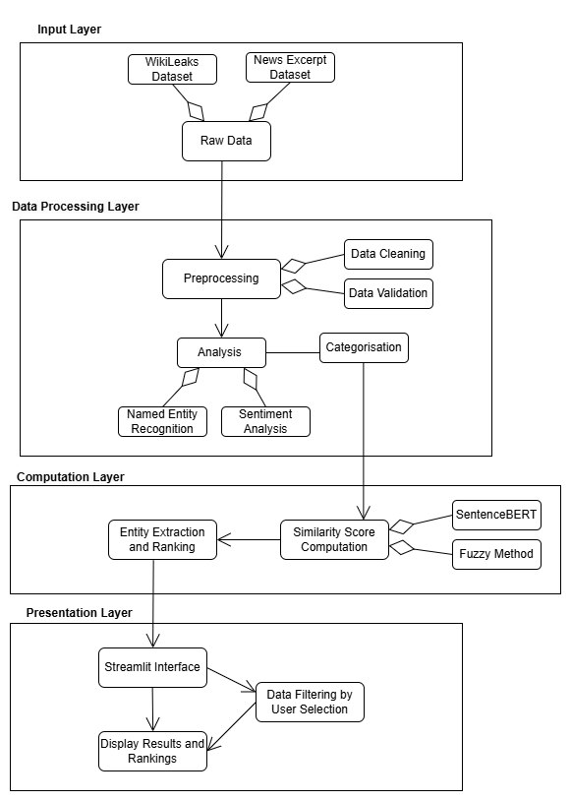
Solution Architecture + Frameworks
Frameworks:
Backend:
Python
Models:
Fuzzy Matching
Sentence-BERT
Named Entity Recognition (NER)
Frontend:
Streamlit
Visualisation:
Seaborn, Matplotlib, Pyvis, Plotly
Notes:
Separate layers (folders and notebooks), less cohesion → good

Slide 7
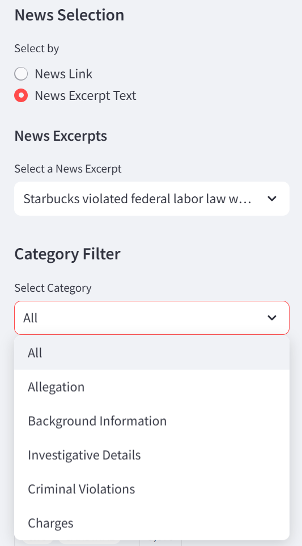
User Experience & Design
User-friendly minimalistic interface:
Search by categories in the sidebar
Instantly visible similar articles
Interactive visualisations
Impact on ISD Workflow:
Quick analysis: Efficiently detect key connections across large datasets
Enhanced decision making: Support more informed decisions
Notes:
User-friendly minimalistic interface:
Allows users to refine their search by categories in the sidebar, helping analysts focus on the most relevant topics
Instantly visible similar articles: Displays the three most relevant articles, making it quick and easy for analysts to spot the closest matches
Interactive visualisations: The interface supports dynamic exploration of relationships between entities
Impact on ISD Workflow:
Quick analysis: Helps analysts efficiently detect key connections across large datasets of news and leaks
Enhanced decision making: Visual tools support more informed decisions when assessing the validity of reports and detecting emerging security threats

Slide 8
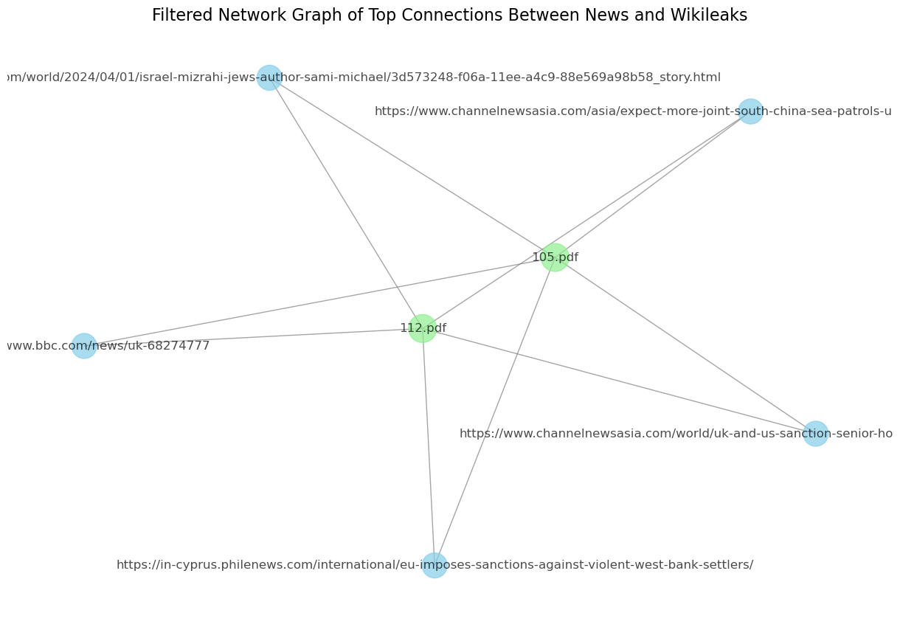
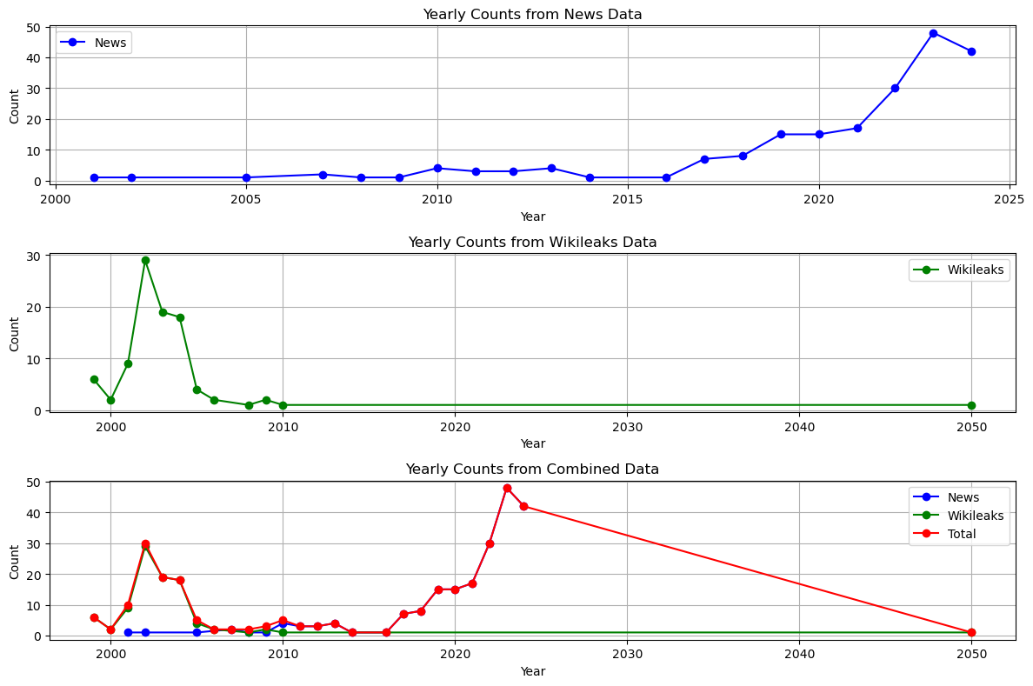
Data Insights & Impact
Network graphs:
help reveal strong connections between entities, aiding in the detection of disinformation and security threats.
Time series analysis:
reveals trends in news coverage and leaked documents based on the years they reference

Slide 9
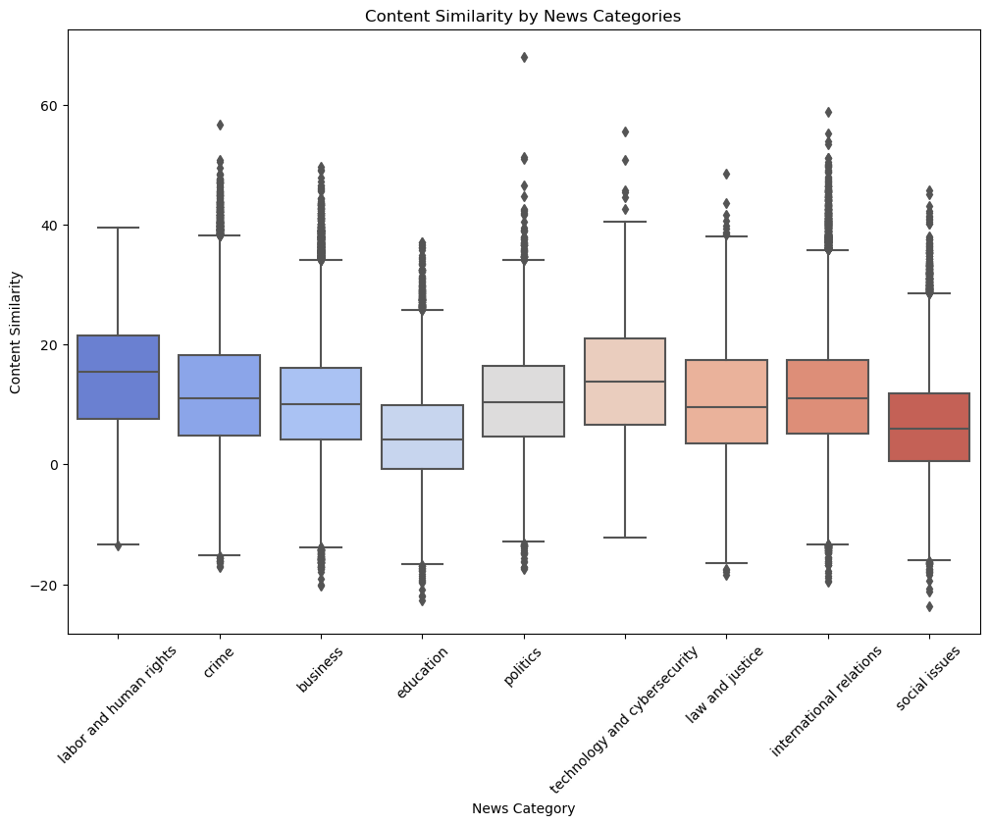
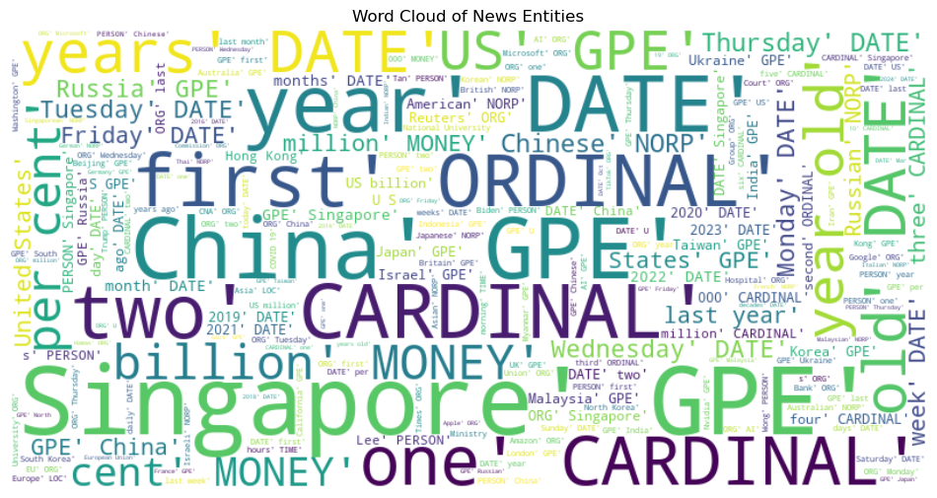
Data Insights & Impact
How would you write an algebraic expression for "three times the sum of a number and 5"?
Can you explain the distinction between the area and perimeter of a shape? Provide an example for each
What is the result when you add 1/3 and 1/4? Express your answer as a simplified fraction
Word clouds:
provide a high-level overview of frequently discussed topics, facilitating quick thematic analysis.
Similarity score distribution:
highlights document alignment, helping detect discrepancies or biases.
1
2
3

Slide 10
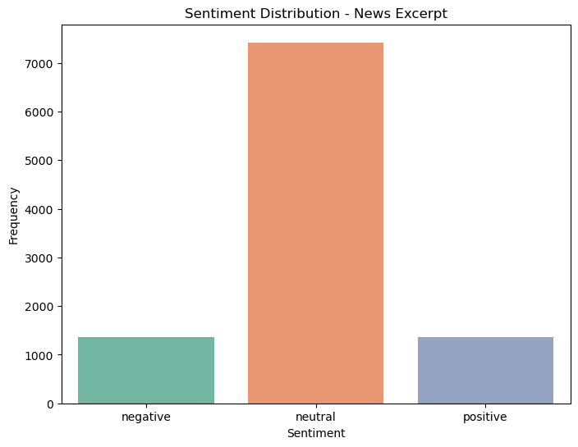
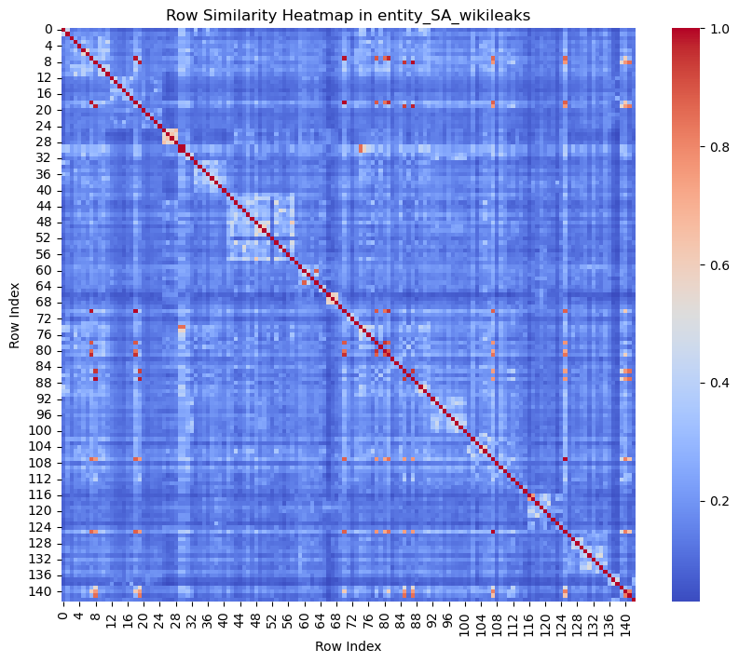
Data Insights & Impact
How would you write an algebraic expression for "three times the sum of a number and 5"?
Can you explain the distinction between the area and perimeter of a shape? Provide an example for each
What is the result when you add 1/3 and 1/4? Express your answer as a simplified fraction
Sentiment Distribution:
helps identify the tone of news coverage and leaked documents
Heatmaps:
visualise the concentration of key entities or topics across different sources
1
2
3

Slide 11
Actionable Insights
01
02
03
04
Validated
Reports
DIvergent
Narratives
High similarity scores suggest credible news, potentially based on prior disclosures
Large differences in similarity scores can uncover discrepancies, omissions, or biases
Emerging
Topics
Media
Influence
Repeated entities and topics across news and leaks signal ongoing investigations or trends
More frequent appearance of entities/topics in mainstream news may reveal editorial priorities
Notes:
Validated Reports: High similarity scores suggest credible news, potentially based on prior disclosures.
Divergent Narratives: Large differences in similarity scores can uncover discrepancies, omissions, or biases.
Emerging Topics: Repeated entities and topics across news and leaks signal ongoing investigations or trends.
Media Influence: More frequent appearance of entities/topics in mainstream news may reveal editorial priorities.

Slide 12
Insights’ Impact on ISD
Early
Detection
Proactive Monitoring
Actionable Findings
Rapidly identifies narratives that may be disinformation or contain security threats
Allows ISD to stay ahead of emerging risks by analyzing how entities are covered across multiple sources
Provides concrete visual and numerical insights to support intelligence decision-making

Slide 13
Demo Walkthrough
01
Explore our analysis tool!

Slide 14
Business Case
Increased Efficiency
Enhanced Accuracy
Actionable Insights
Automation reduces time required to identify threats
Combination of models ensures nuanced comparison
Detect threats early by identifying hidden patterns
Scalability
Performance Optimisation
User-Friendly Interface
Dynamic filtering & exploration
Optimised caching for real-time analysis
Designed to handle large datasets efficiently
Notes:
Increased Efficiency: By automating the comparison and analysis of news articles and leaked documents, the platform drastically reduces the time required to identify potential threats or disinformation campaigns.
Enhanced Accuracy – The combination of heuristic and deep-learning models ensures a nuanced comparison of documents, minimizing false positives and improving detection of nuanced relationships.
Actionable Insights: The tool helps detect emerging threats early by identifying patterns and entities across multiple sources, allowing ISD to act faster and more proactively, and validate the authenticity of reports with greater confidence.
Scalability – Designed to handle large datasets efficiently, ensuring the system can scale with growing volumes of news and Wikileaks documents.
User-Friendly Interface – The interactive Streamlit-based frontend allows users to filter results, explore entity relationships, and dynamically adjust similarity thresholds.
Performance Optimization – Through caching and backend optimizations, response times remain quick, making real-time analysis practical for end users.

Slide 15
Why does ISD need this?
01
02
03
As risks evolve quickly, ISD needs a smarter and faster way to detect threats, ensuring they can adapt quickly to emerging challenges and stay ahead of new threats
Faster Threat Detection
Improved Decision Making
Making ISD’s workflows simpler
Speeds up threat detection & response
Clear actionable insights for informed decision making
Tool streamlines tasks, helping analysts focus on what matters most

Slide 16
Future Extensions
Public news
Wikileaks
ISD can apply
Public can apply
Public news
To be analysed
ISD internal
database
User input
News and/or link
ISD selected
database

Slide 17
QNA

Slide 18
Thanks!
Please keep this slide for attribution

